Slide 1
Integrating Replication Tools with Data Repositories
Matthew K Lau and Mercè Crosas
IQSS, Dataverse, Harvard Forest
Harvard University

Slide 2
Increase in Data Sharing
In the last decade, data sharing has become more common in the social sciences:
An increasing number of journals are adopting data policies
More data repositories are available to share research data

Slide 3
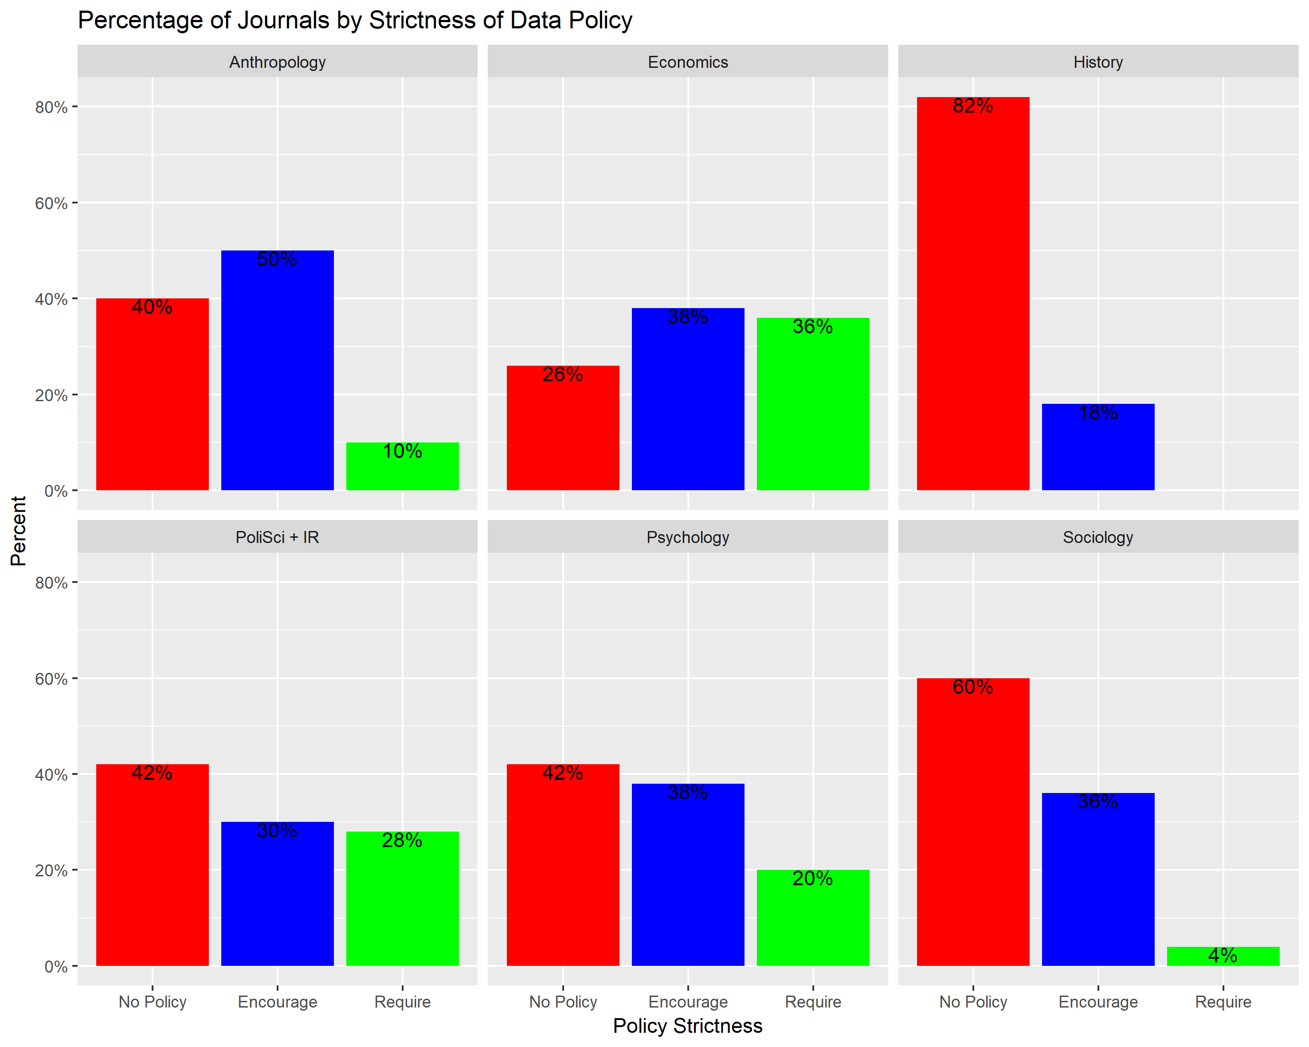
Data Policies use in Social Science Journals
More than 50% of journals in anthropology, economics, political science, psychology, and sociology have data policies that either encourage or require to share the data associated with the article.
Crosas, Gautier, Karcher, Kirilova, Otalora, Schwartz, 2018. Data Policies of highly-ranked social science journals

Slide 4
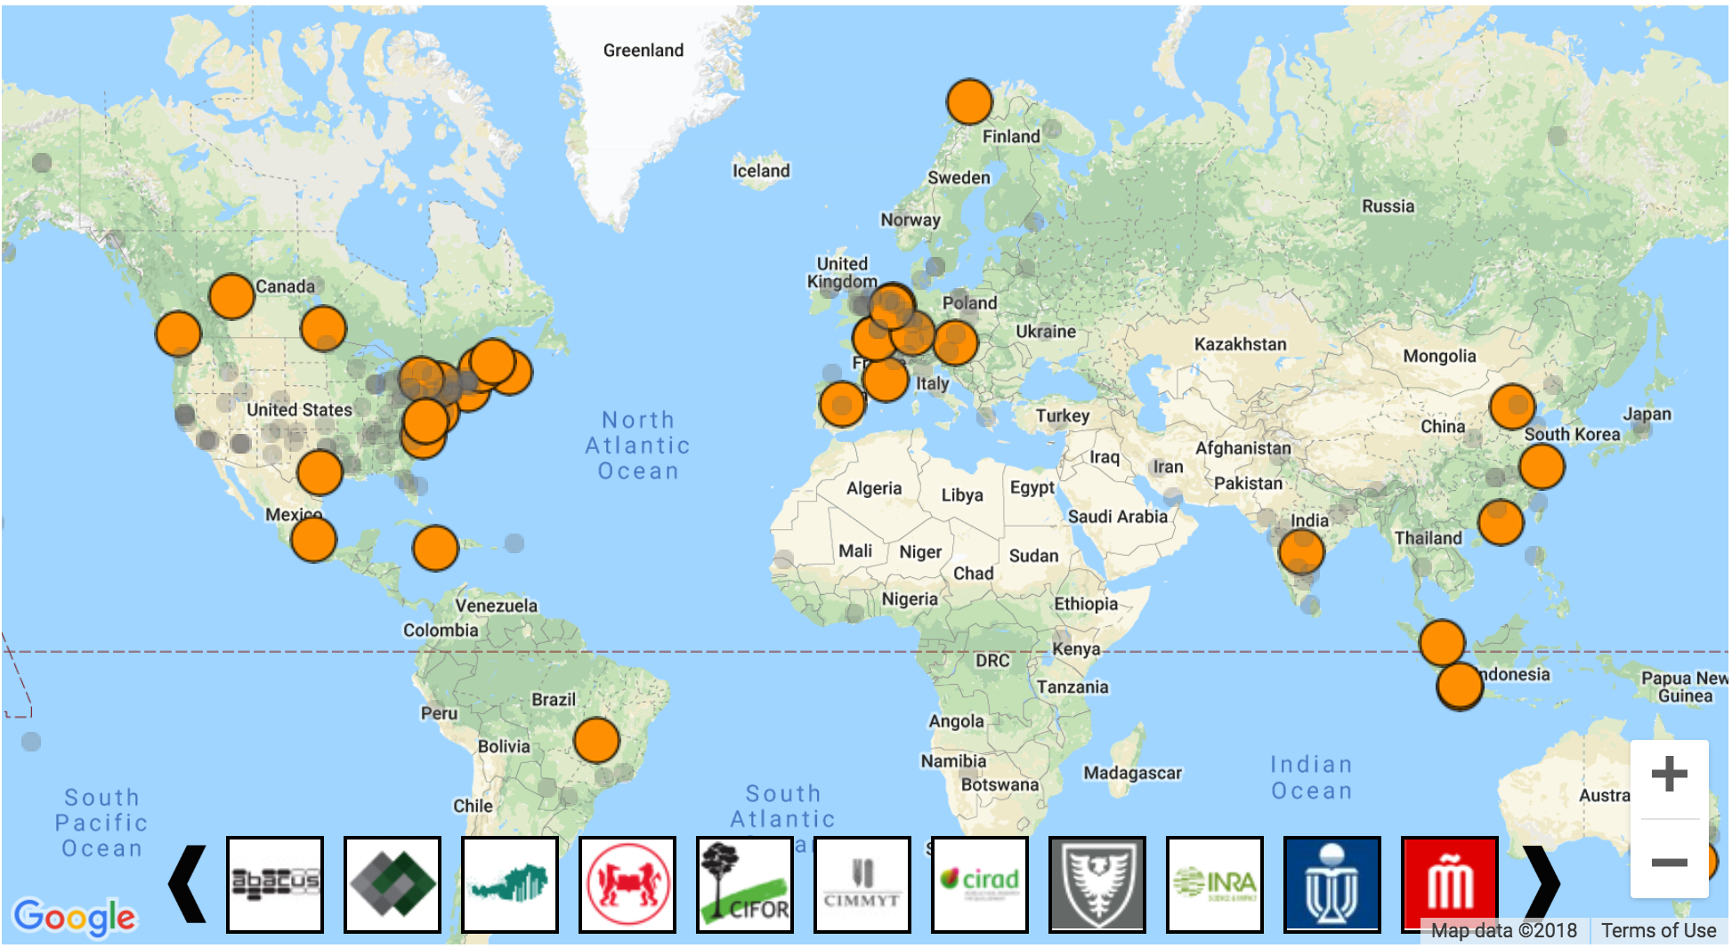
Data repositories around the world powered by Dataverse
In the last year:
From 23 to 33 Dataverse repositories
From 49,000 to 53,000 datasets in Harvard Dataverse
https://dataverse.org/

Slide 5
But, are these shared data reusable?
Can the shared data be used to:
Replicate previous studies
Run new studies using existing data
For this, we need:
Well-documented, well-organized data and code
Tools that facilitate replication and reuse

Slide 6
Alfred P. Sloan grant
With funding from the Sloan Foundation, we plan to address reuse and reproducibility by:
Improving curation through educational materials, friendly UI, and services
Integrating replication tools with Dataverse repositories:
Encapsulator to pack your data and code in a self-contained and documented resource
Code Ocean to easily run scientific code online
CoRe2 to connect systems to streamline the verification workflow (ODUM Instititute)

Slide 7
Easier reproducibility for scientists with encapsulation

Slide 8
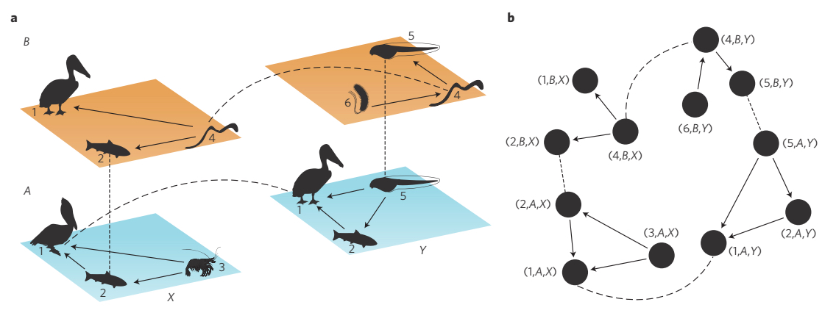
Notes:
I’m a quantitative ecologist, and so I spend most of my time thinking about ecosystems and how to analyze them. And over the years, my software needs have far outpaced commercial development.

Slide 9
Software should not limit science.
Notes:
So, I have been a open-source analytical software developer, educator and advocate for nearly 10 years.

Slide 10
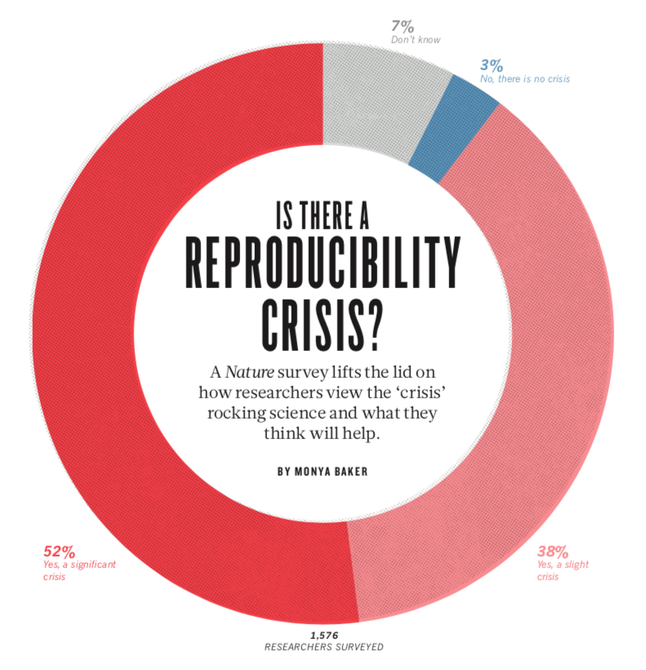
Notes:
A couple years ago, I, like many other scientists, was troubled by the “expose” on scientific reproducibility (or ir-reproducibility) that apparently was abundant across all of science.

Slide 11
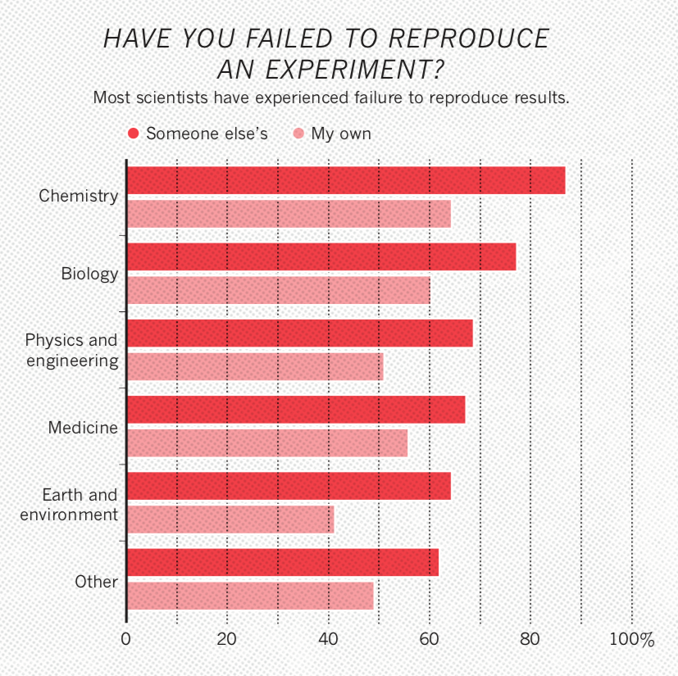
Notes:
Biology was particularly troubled, according to the results, and I would assume that ecology would on the more troubled edge of the spectrum given the typically small sample sizes and highly complex, multivariate systems studied.

Slide 12
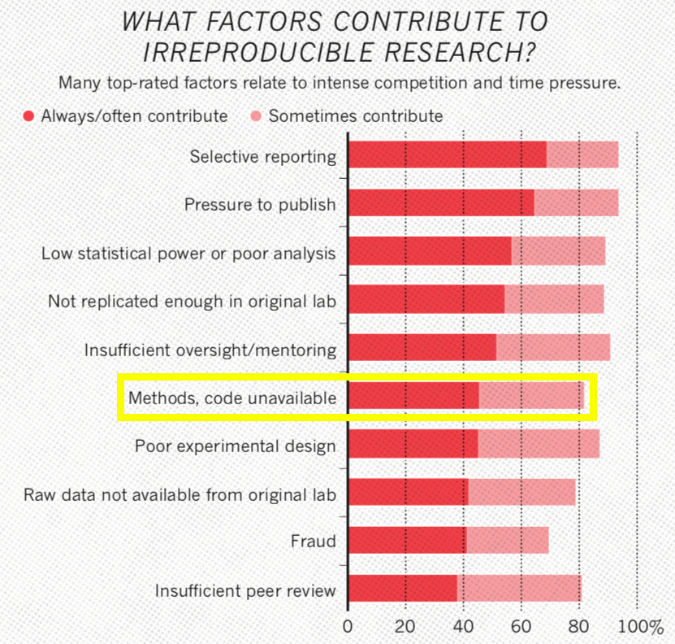
Notes:
Not surprisingly, though not at the forefront of my thinking, code was mentioned as a major issue.

Slide 13
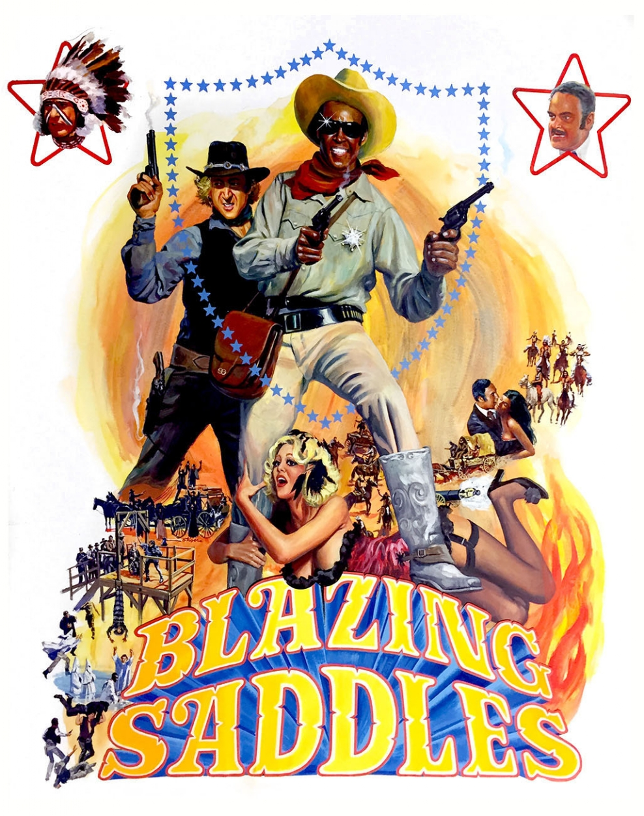
Notes:
This should not have been surprising given my experience with analytical software, my own, my students and my colleagues.

Slide 14
Notes:
Beautiful unique snowflakes of code as intricate and awkward as a rube goldberg machine.

Slide 15
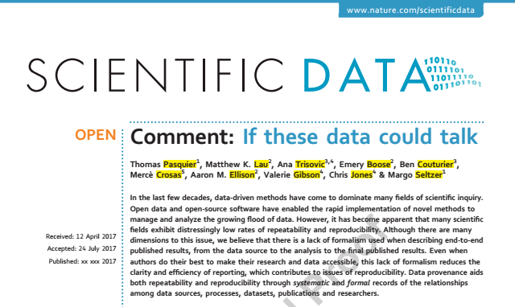
Notes:
So, in collaboration with folks at CERN, University of Cambridge and Mt Holyoke, we wrote a paper highlighting important issues.

Slide 16
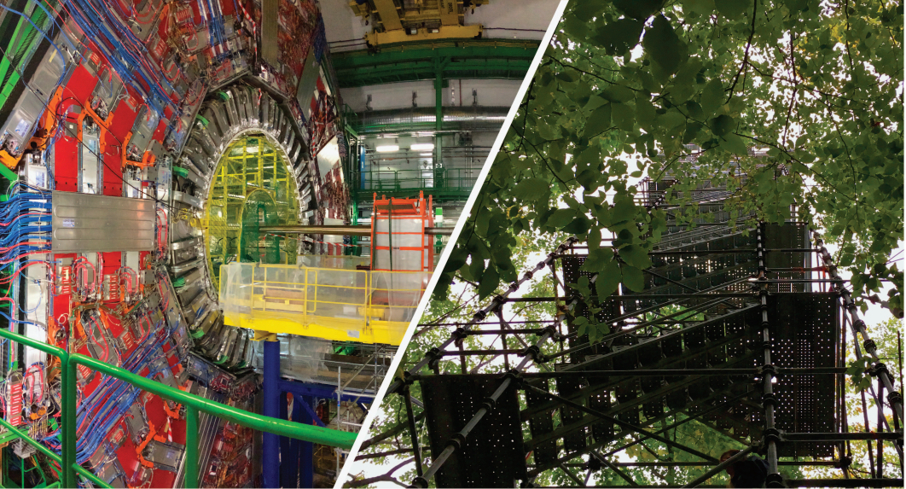
Notes:
The main thrust being, the sciences (whether particle physics or ecosystem ecology) have rapidly become computationally intensive. and given the constraints placed on most domain scientists, they want to do their work, not spend seemingly extra time refactoring code that has already produced results (i.e. if it’s not broke, you don’t have time to fix it).

Slide 17
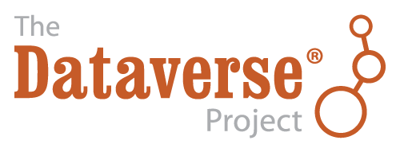

Slide 18
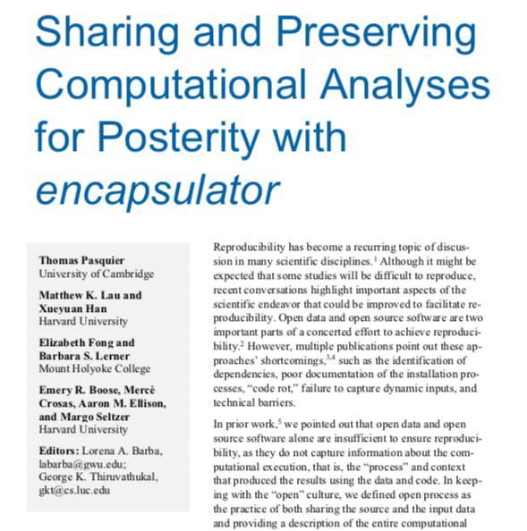
IEEE: Computing in Science & Engineering 2018
Notes:
In collaboration with Mt Holyoke and the other Cambridge, we developed a tool to conduct encapsulation.

Slide 19
Encapsulator
Purpose: Simplify computational reproducibility
Create a data “capsule” (code + data + environment)
Increase transparency with “cleaned” code

Slide 20
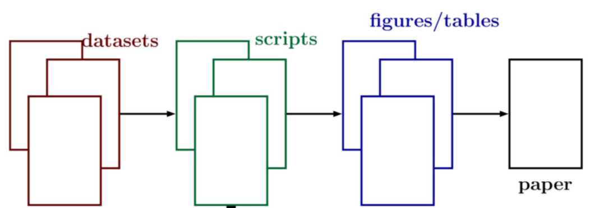
Notes:
Basic workflow from data to publication.

Slide 21
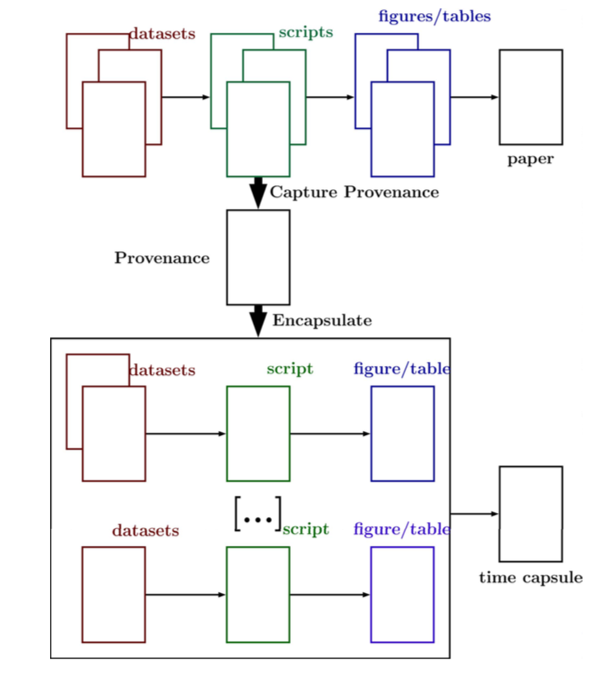
Notes:
Encapsulation creates a “capsule” based on a set of results (likely a subset) using data provenance.

Slide 22
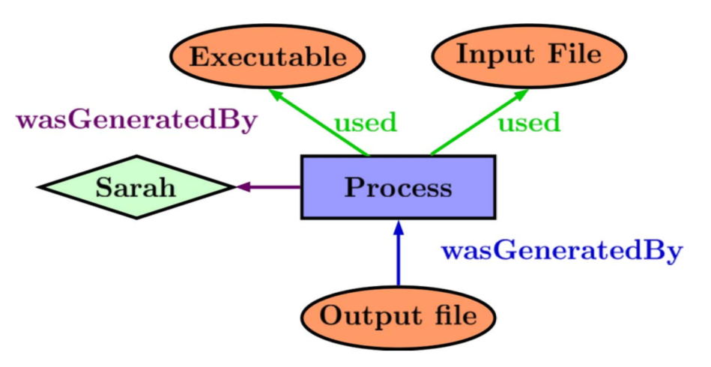
What is data provenance?
Notes:
Data provenance is a formal representation of a computational process that produced a result.

Slide 23
Prov. Huh. What is it good for?
Notes:
For more complex analytical pipelines, provenance is a formal way to deal with the tangle of processes and data

Slide 24
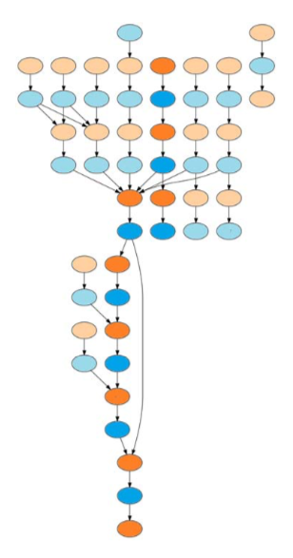
Notes:
Data provenance is used by encapsulator to 1) clean code by finding the essential code pathway, 2) locate and re-organize pathways and 3) get environment details (e.g. libraries).

Slide 25
Future Work
Challenges: domain-specific environments, improved code cleaning (Rclean), Capsule OS (Linux), nondeterminism
Testing Dataverse products
Integration with IDEs (RStudio)
Container Support (e.g. Docker)
Email: matthewklau@fas.harvard.edu
Github: MKLau
This work was supported by NSF grants SSI-1450277 (End-to-End Provenance) and ACI-1448123 (Citation++).
More details about those projects are available at https://projects.iq.harvard.edu/provenance-at-harvard.

